Slide 1
Visualize me project
Present by
Gredel, Mohammed, Evans, Kaiser and Maria

Slide 2
Purpose
Our employer is looking to expand their marketing efforts for their wellness/weight loss product line. We as employees have been tasked with providing an interactive html to provide insight for cities within the United States that have a high adult obesity rate. To accomplish our goals, we will retrieve data from the following website through reading their CSV or JSON file. The data will be transformed in a Postgresql data.

Slide 3
Datasets CDC dataset provided the obesity by gender (age: 18 and older)/state https://chronicdata.cdc.gov/resource/hn4x-zwk7 Census Bureau dataset provided the population estimates by state for 2014 https://www.census.gov/data/tables/time-series/demo/popest/2010s-state-total.html Data.gov dataset provided the City, State obesity information for the heat map https://catalog.data.gov/dataset/500-cities-local-data-for-better-health-2016-release

Slide 4
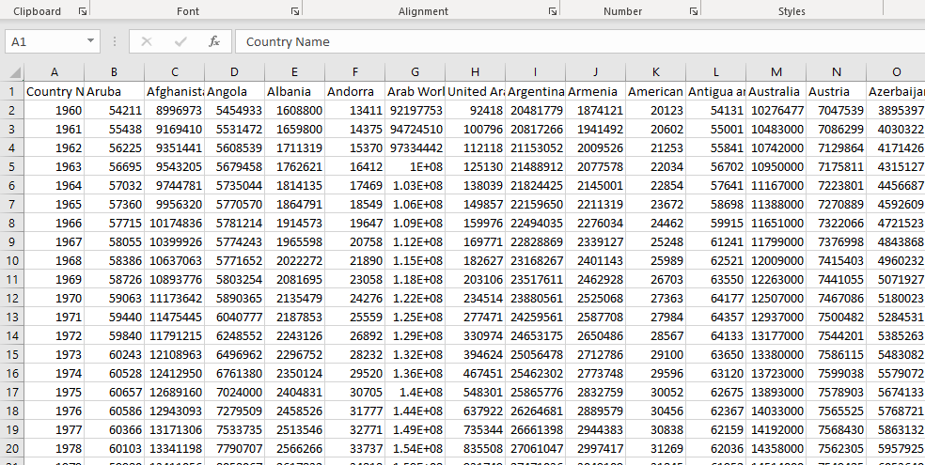
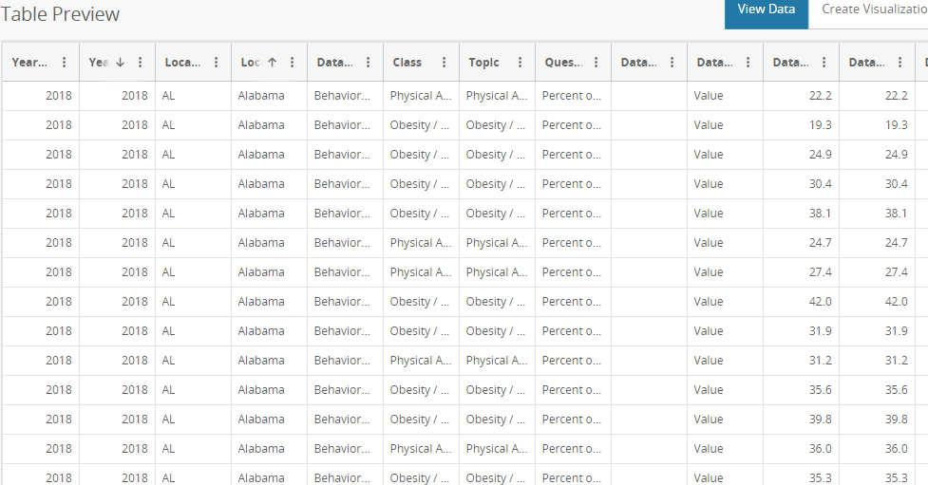
Original data
Total population
Cdc data

Slide 5
Cleaning data
There is a column that was called GEOLOCATION that had coordinates. The brackets were removed and the column was split into two to represent LONGITUDE and LATITUDE. The values were reduced to 2-decimal places
All the data was filtered and we were left with 25k columns
After everything was done, the clean data was copied to a new sheet

Slide 6
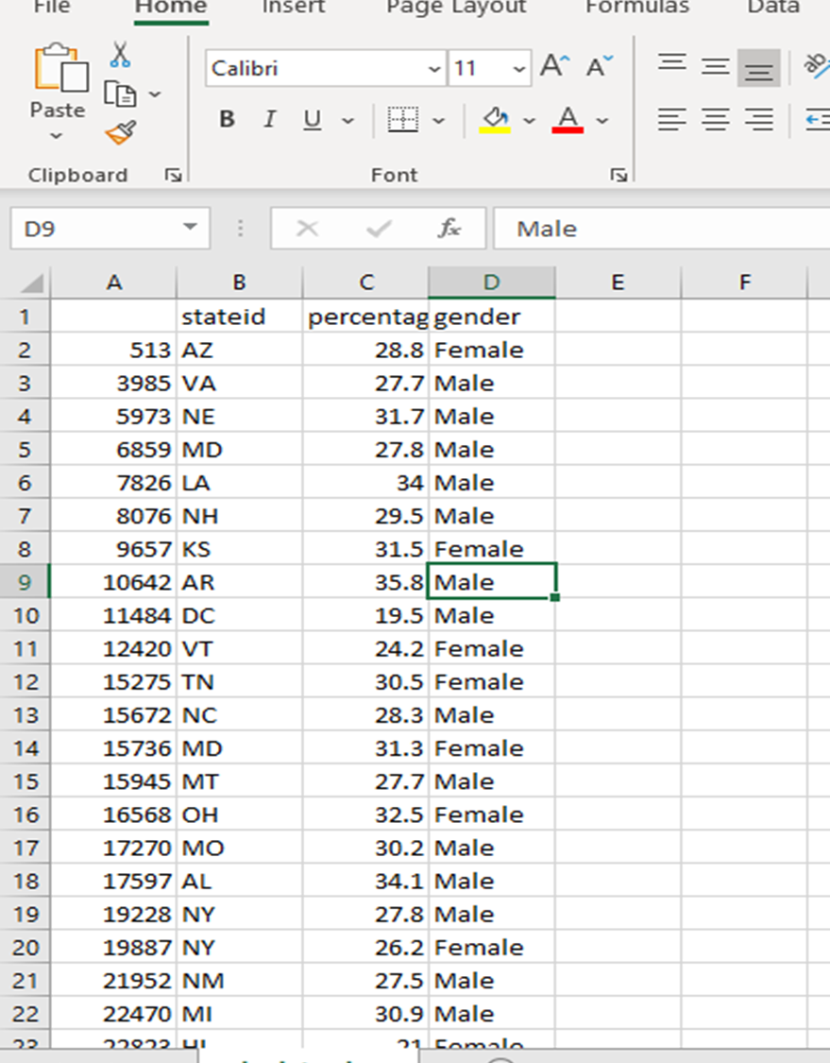
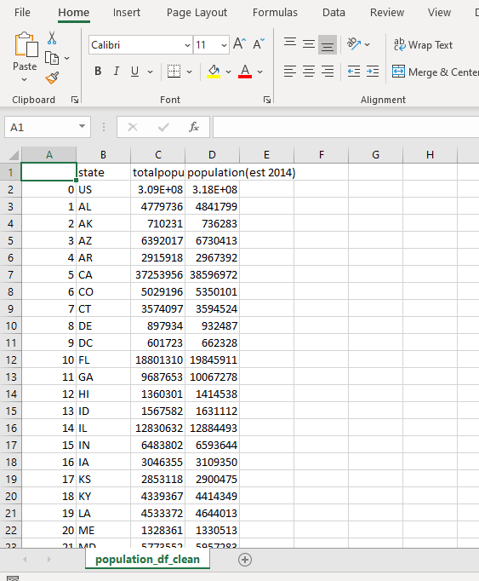
Clean data
cdc_data_clean.csv
population_df_clean.csv

Slide 7
Jupyter notebook
Clean data was uploaded to jupyter notebook and filtered

Slide 8
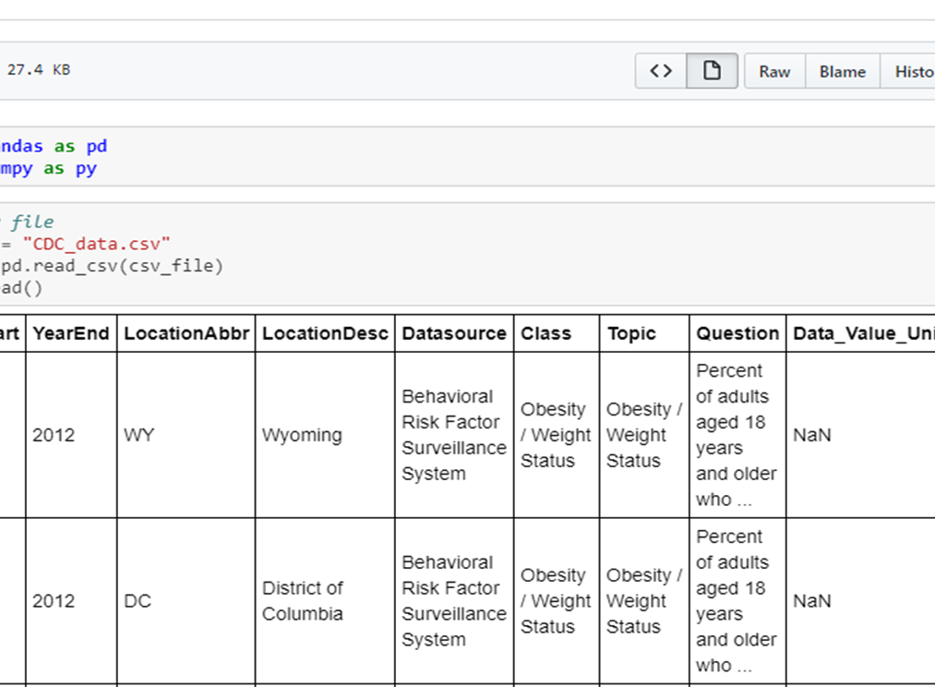
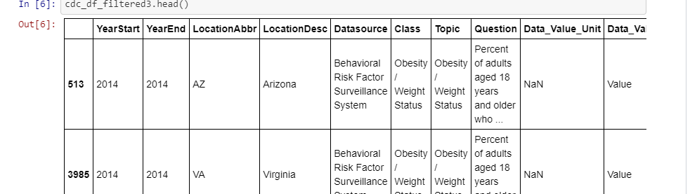
Jupyter notebook
Cdc-data
Population data

Slide 9
Filtering data
The cdc-data is filtered to concentrate on 18 years and above
And it was based on the year 2014
The csv files are merged and drop unnecessary columns using the function DROPNA
Columns were renamed using the function RENAME. This was to be used in PgAdmin because it is case sensitive

Slide 10
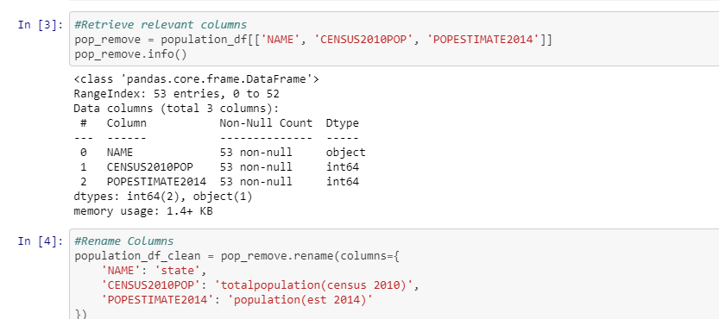
Population data
The data was filtered and renamed for PgAdmin

Slide 11
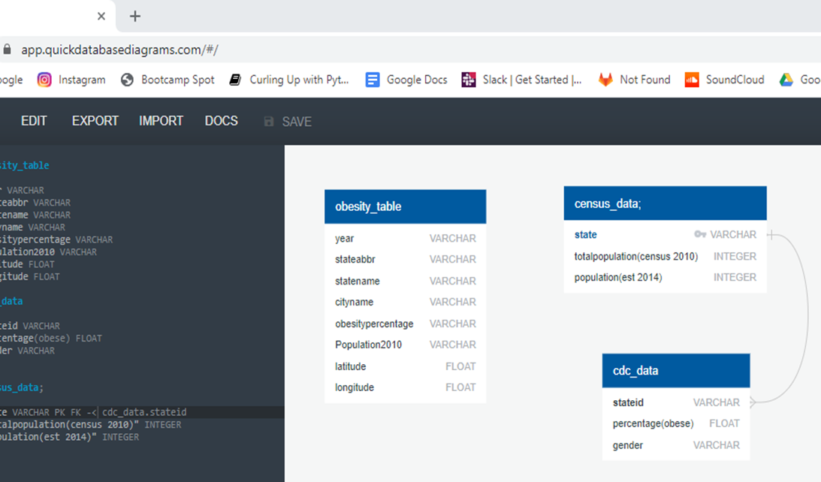
Postgres
Three tables were created in PgAdmin
Obesity table
Census_data
Cdc_data

Slide 12
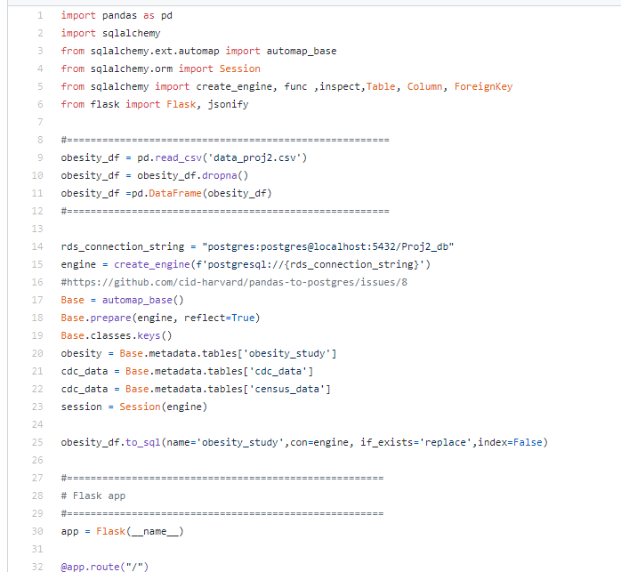
Flask application
Postgress is connected to the flask application on python

Slide 13
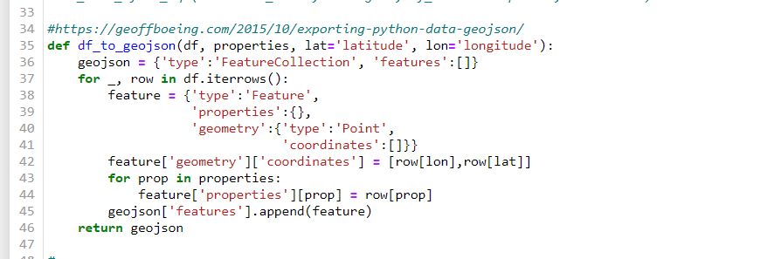
Flask application
Flask app reads data from csv and writes to prostgres database.
Heatmap required GoeJson. This is the Code to convert our dataframe to geojson

Slide 14
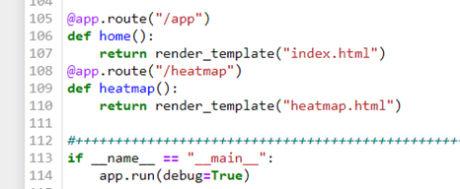
• Chose to use postgres for our Database • Because of Cross origin issues, we had to render our index from our flask app.

Slide 15
Heat map
visualization type is leaflet heatmap with point markers and popup function that shows city name, sample size and obesity percentage
map has legend with color scale
data type is geojson file with latlng geometry that converted from sql table.
sql table created from csv data.
data are filtered in flask app to represent only point with obesity percentage more than or equal to 45 %.
data loaded from api using pandas flask app route
we used a plugin in our heat map from link https://github.com/k4r573n/leaflet-control-osm-geocoder it is a leaflet control geocoder that uses the Open street Map geocoder to locate places.

Slide 16
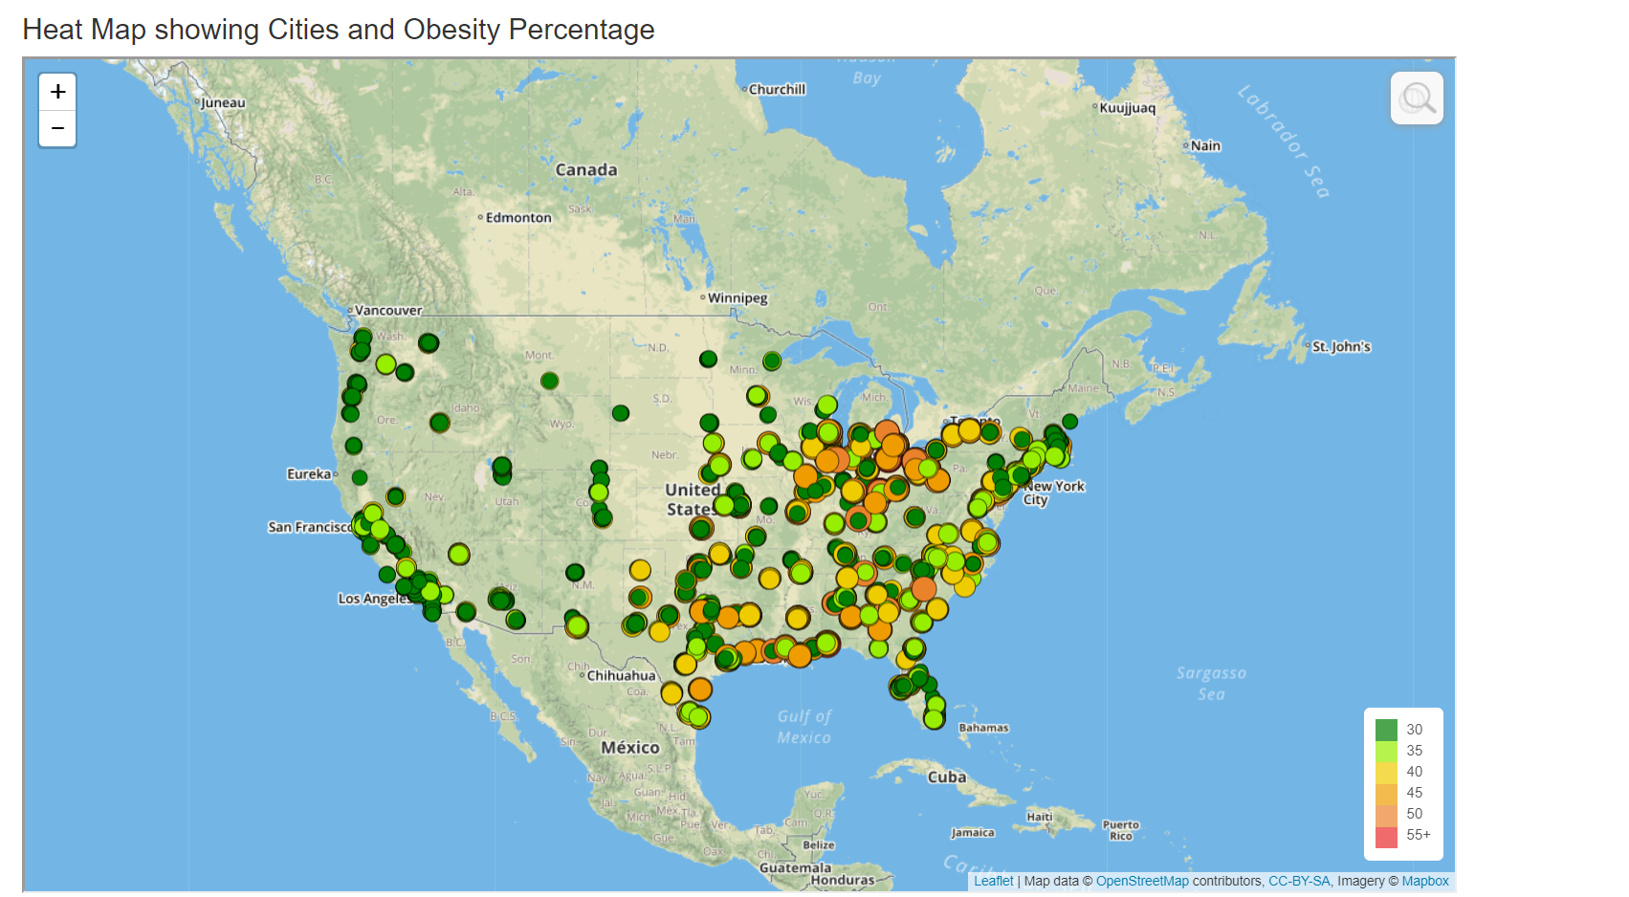

Slide 17
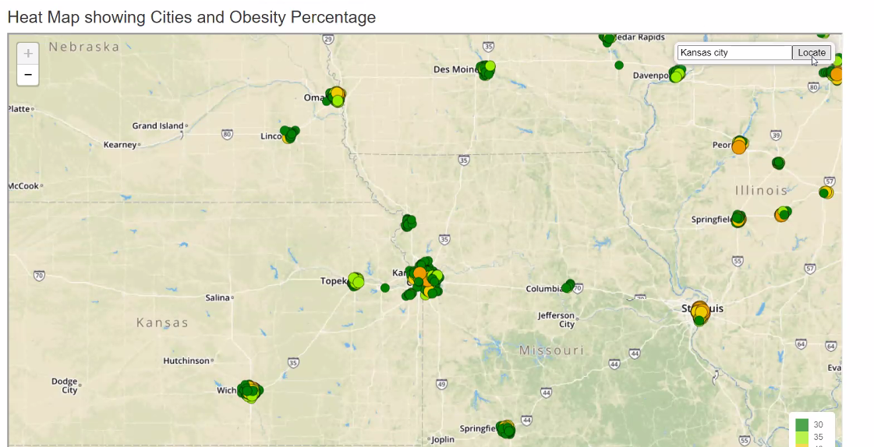

Slide 18
HTML
We used visual studio code to create code for the website of the company
We also created a JavaScript file that was used for visualization which is a bar graph

Slide 19
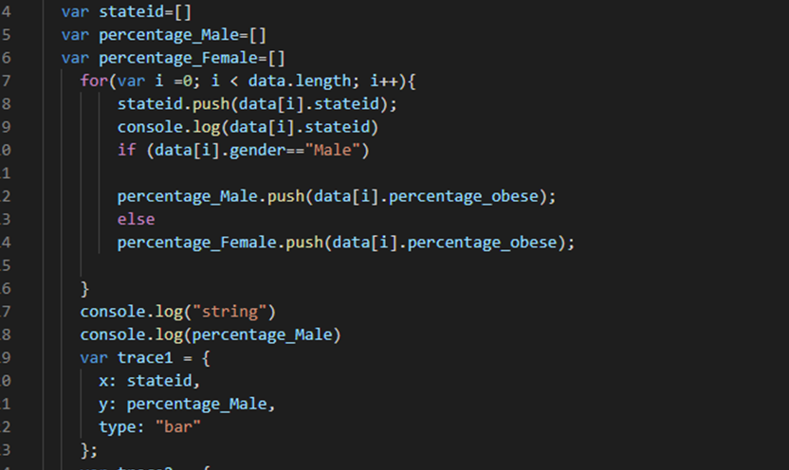
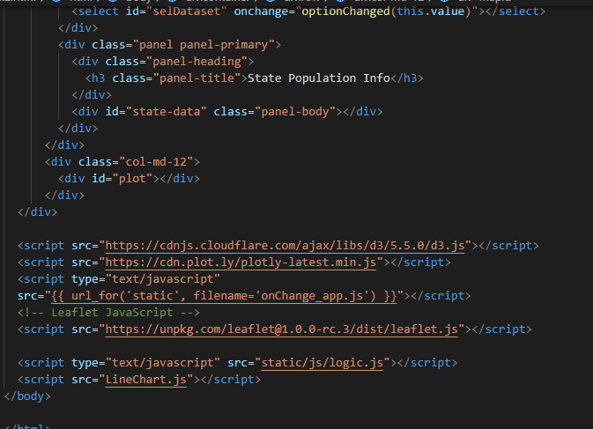
Index.html and LineChart.js

Slide 20
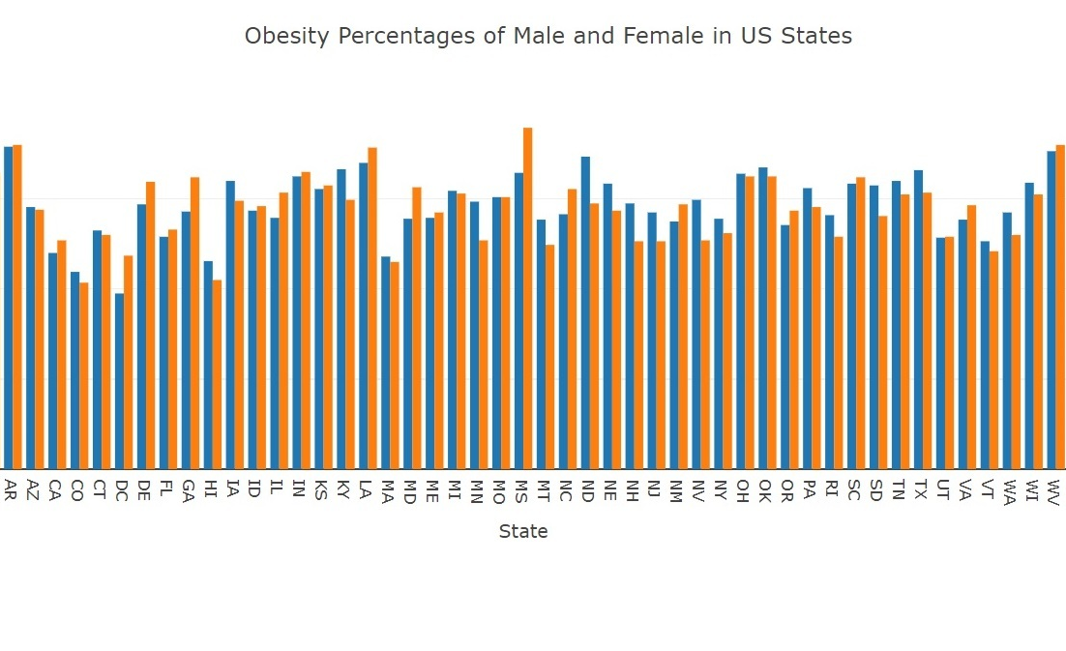
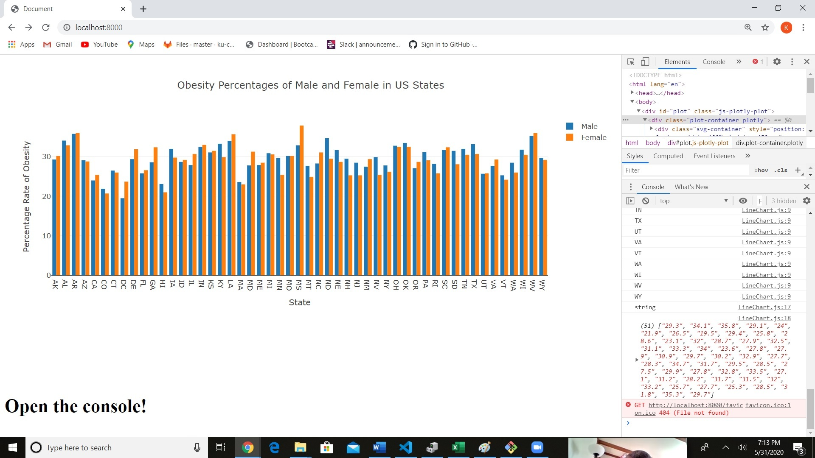
Bar Graph
I took the CSV data and had StateId, Percentage of Male and Female obesity rates identified as variables.
Used IF statement to seperate male and female data within each state
Used Bar type to create bar chart.
Used Plotly to create a bar graph

